Slide 1
What is Big Data?
Fahad Maqbool
Assistant Prof. Dept of CS&IT University of Sargodha PAKISTAN | Collaborative Research Smart Data Lab University of Bonn Germany

Slide 2
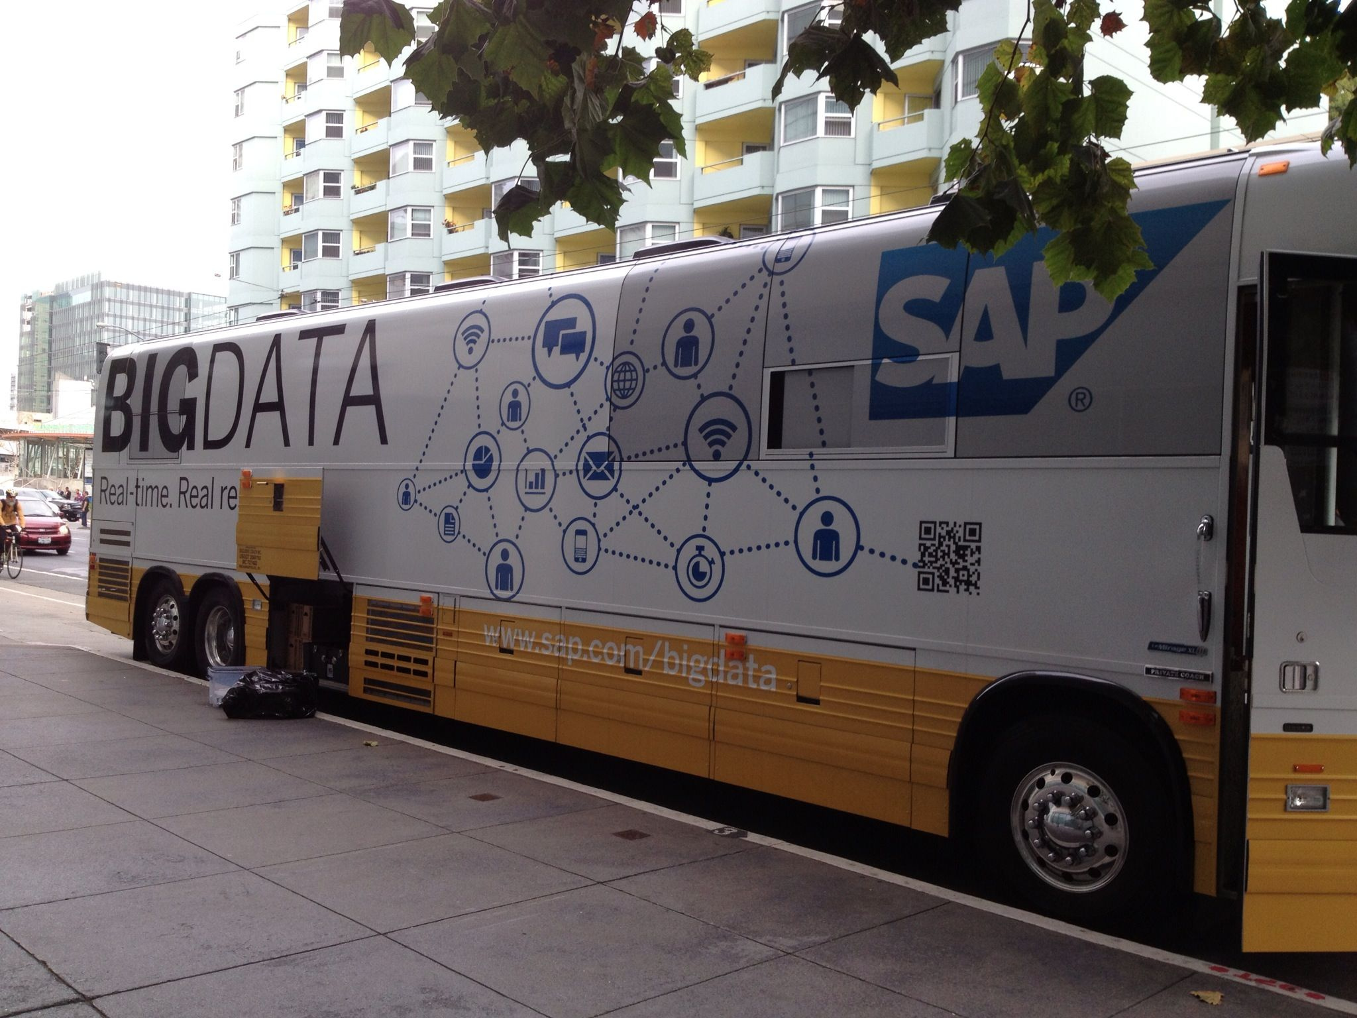
AGENDA
WHAT IS BIG DATA?
SUCCESS OF BIG DATA
Potential OF BIG DATA

Slide 3
BIG
WHAT IS ?
HOW MUCH BIG IS BIG?

Slide 4

What is big data ?
BIG is relative
Naïve Def.
Large collection of Information
Is data in my laptop BIG ???
Industry generally treats data beyond terabytes and petabytes as BIG DATA

Slide 5
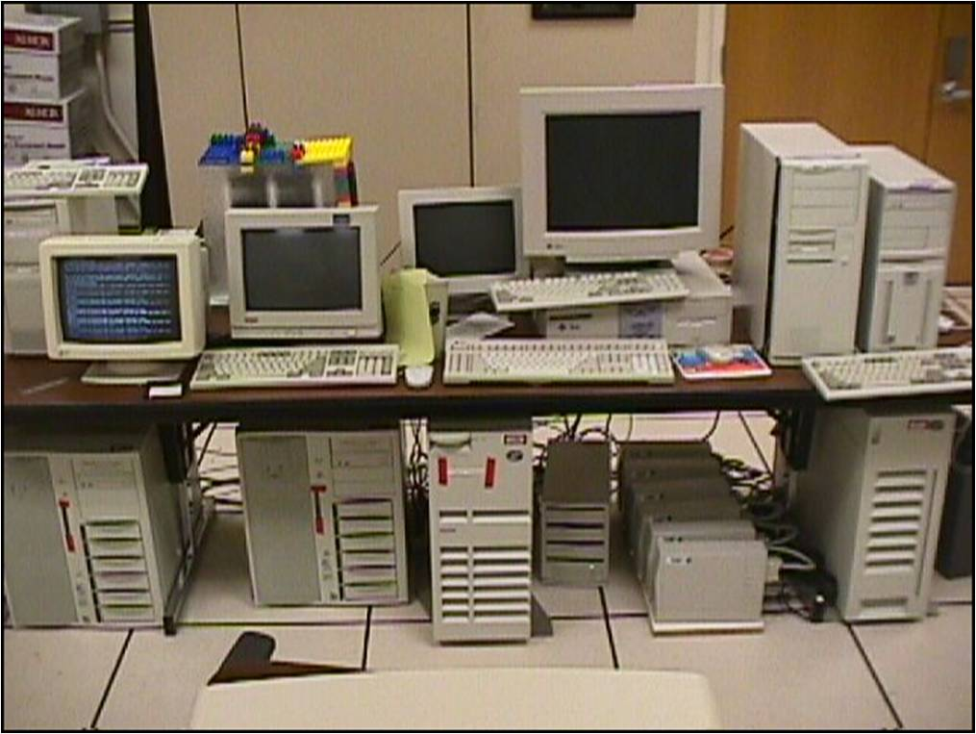
Google: 1997

Slide 6
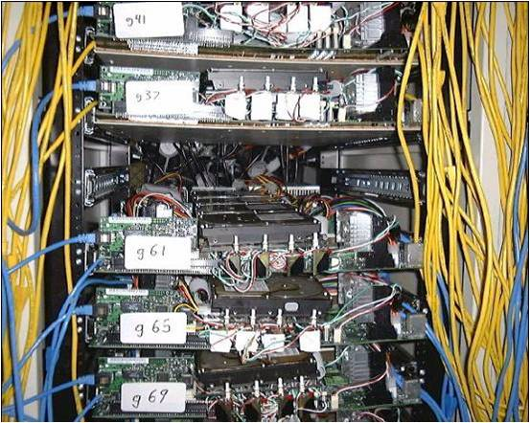
Google: 2001
Commodity CPUs
Lots of disks
Low bandwidth network

Slide 7


Data Growth
Google as of 2009 processes 24 petabytes of data everyday.
1 Rice Grain = 1 Byte
1 Rice Bowl = 1024 Byte

Slide 8

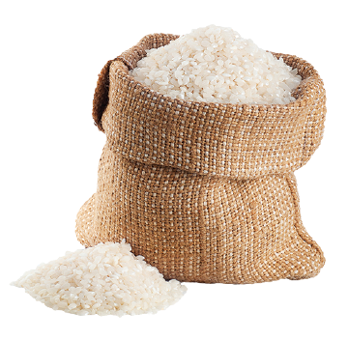

Scale Of Data
1 Rice Bag = 1 Mega Byte
2 Rice Containers = 1 GB

Slide 9

Scale Of Data
2048 Rice Containers= 1 Tera Byte

Slide 10
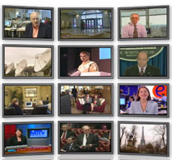

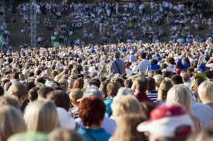

Model Has Changed
Data generation/consumption model has changed.
Old: Few companies are generating data – All others consuming data
New: All of us generating data – All of us consuming data

Slide 11
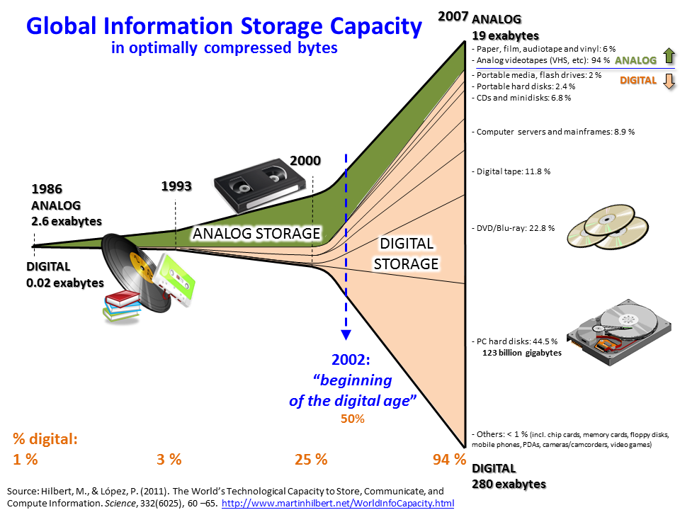

Slide 12
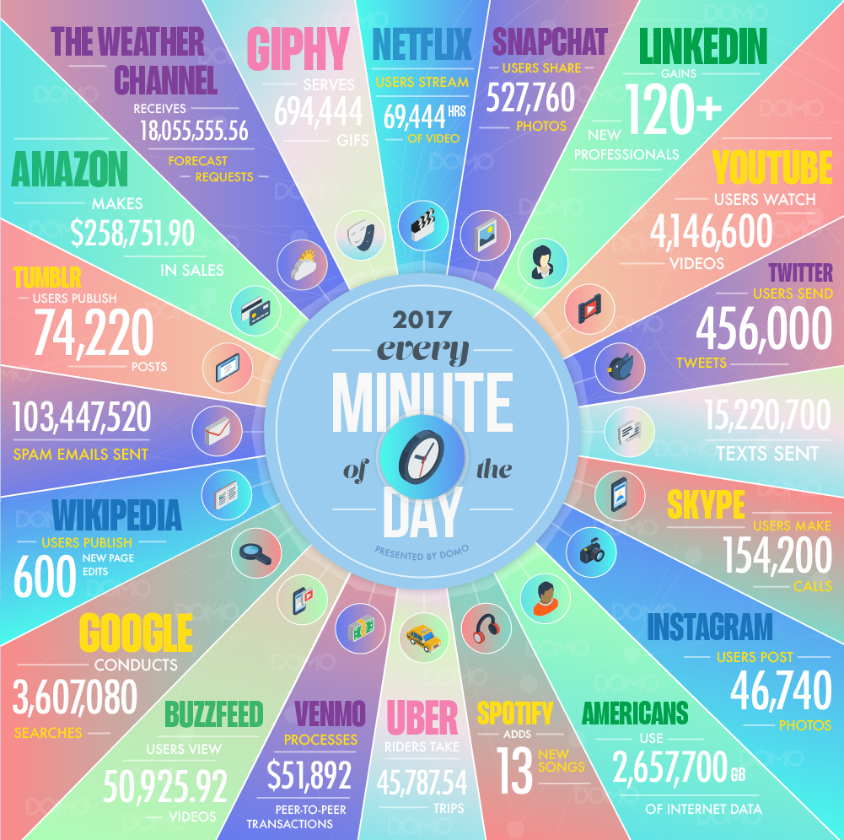
DATA NEVER SLEEPS

Slide 13
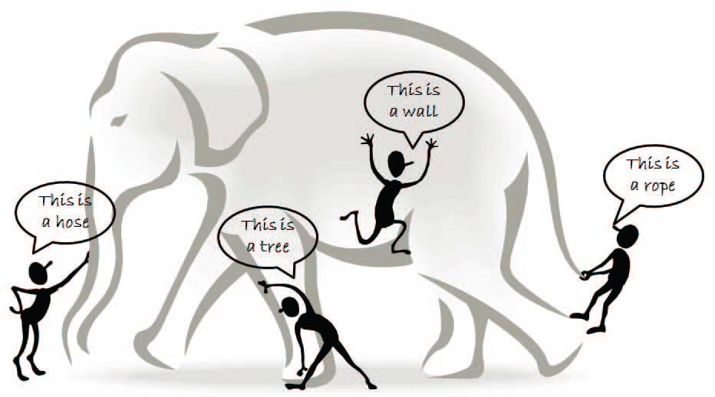
The blind men and the giant elephant: the localized (limited) view of each blind man leads to a biased conclusion
Source: Data Mining with Big Data, Xindong et. al.

Slide 14

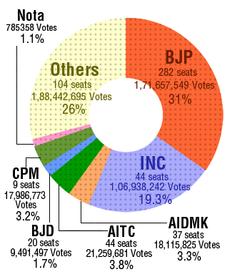
Application Areas: Government
2012
Obama Administration: How big data could be used to address important problems faced by the government?
Big data analysis played a large role in Barack Obamas successful reelection campaign.
2014
2014: Big data analysis was tried out for the BJP to win the Indian General Election.

Slide 15
Application Areas: Government
2014: Big data analysis was tried out for the BJP to win the Indian General Election.
Indian government utilizes numerous techniques to ascertain how the Indian electorate is responding to government action, as well as ideas for policy augmentation.

Slide 16

Application Areas: Government
China – Predictive Policing based on Big Data
Aggregates data about people – often without their knowledge – and flags those it deems potentially threatening to officials.
© 2017 AFP PHOTO

Slide 17
Big Data Market
Data Scientist
Median Base Salary: $113,000
Job Openings (YoY Growth): (45%)
Career Advancement Score (out of 10): 8
https://blog.linkedin.com/2018/january/11/linkedin-data-reveals-the-most-promising-jobs-and-in-demand-skills-2018
Big Data
Data scientists are becoming a key component in many industries -- from finance and banking to health care and drug discovery. Companies will be investing on a big scale in talent acquisition in this field. - Andrii Buvailo
https://www.forbes.com/sites/forbestechcouncil/2017/12/21/13-top-tech-skills-in-high-demand-for-2018/#76b57c591e5c

Slide 18
QUESTIONS ?

